Slide 1
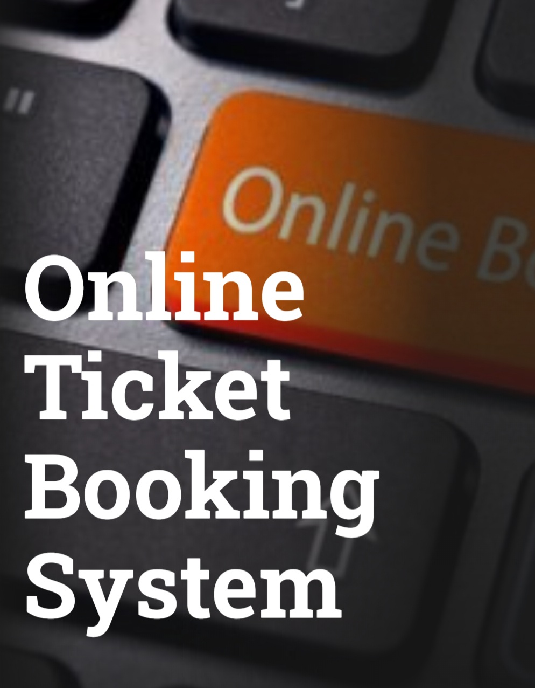
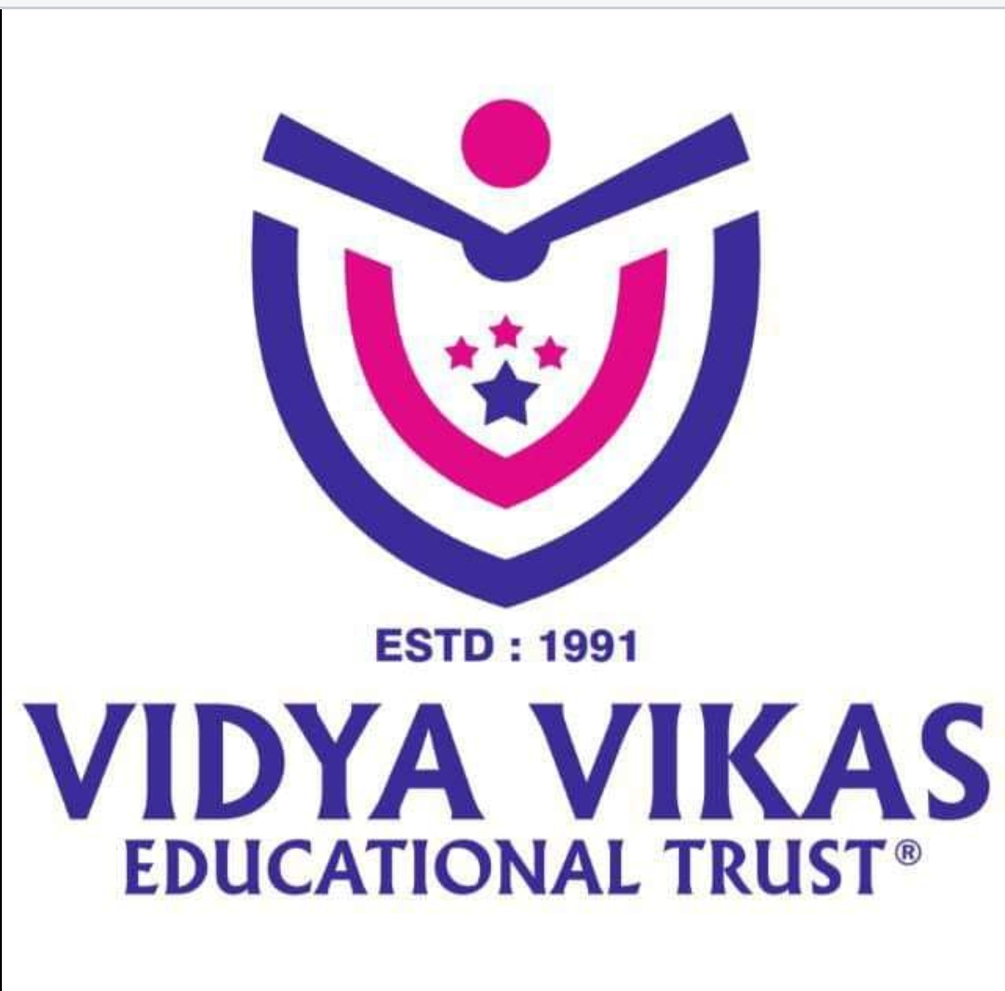
VIDYA VIKAS INSTITUTE OF ENGINEERING AND TECHNOLOGY
Under the guidance of
Mrs. Drashayini. K.B
Asst. Professor
Dept of ISE
Submitted by
Preethi G 4VM18IS025
Sonali S 4VM18IS035

Slide 2
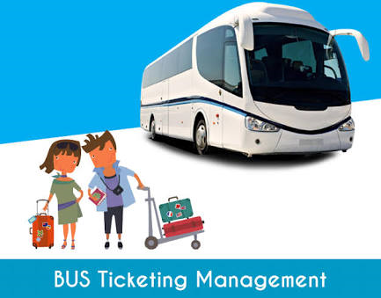
CONTENTS
ABSTRACT
EXISTING SYSTEM AND DEMERITS
PROPOSE SYSTEM AND MERITS
METHODOLOGY
ARCHITECTURAL DIAGRAM
SYSTEM REQUIREMENTS
CONCLUSION
BIBLIOGRAPHY

Slide 3
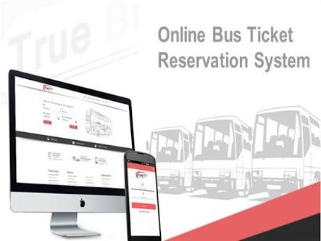
ABSTRACT
Travelling is a large growing business in India and other countries.
We observed the working of the bus reservation system and after going through it, we get to know that there are many operations, which they have to do manually.
It takes a lot of time and causes many errors. Due to this, sometimes a lot of problems occur and they were facing many disputes with customers.
By using this software, we can reserve tickets from any part of the world, through telephones lines, via internet, thus validation done in a effective way.

Slide 4
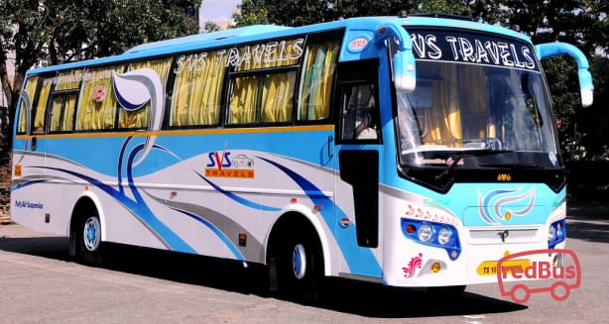
Existing system
The existing bus booking system is not completely computerized.
The customer has to visit any booking branch if he wants to book a ticket or go to travel agents.
This was actually a tedious process and was leading to wastage of time.
Bus scheduling, ticket booking, bill generation and many other operations are done manually.

Slide 5
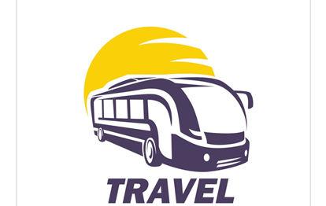
Demerits of existing system
Slow response about refunding
High registration and service charge
Troll free is not available for customer enquires
Low quality customer service

Slide 6
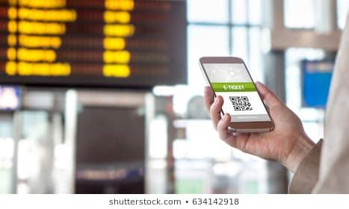
Propose system
We can eliminate the drawbacks by developing an application which will allow customers to register themselves and book tickets, cancel tickets or postpone or prepone travel dates with feasibility.
Development of software in the given time.
To create an effective and efficient application.

Slide 7

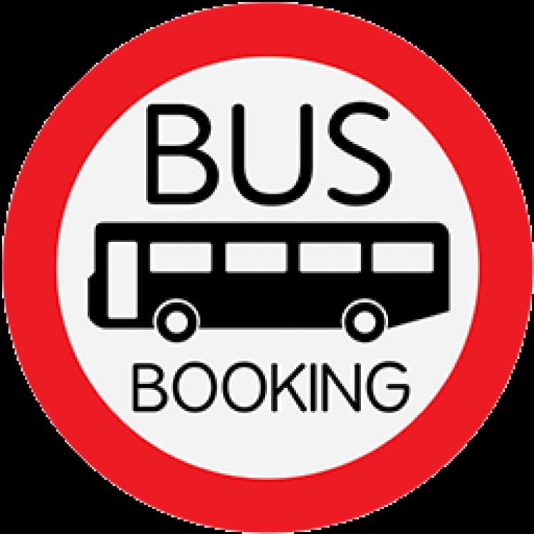
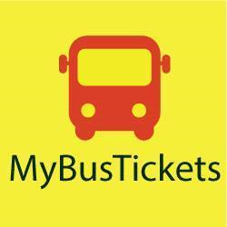


advantages
Bus availability, bus number and bus drivers name will be displayed to the customers.
Arrival and departure time will be displayed to the booked customers.
Saves time.

Slide 8


methodology
The methodology used to design this automated system includes -
Add bus
Reserve seat
Show bus
Bus availability

Slide 9


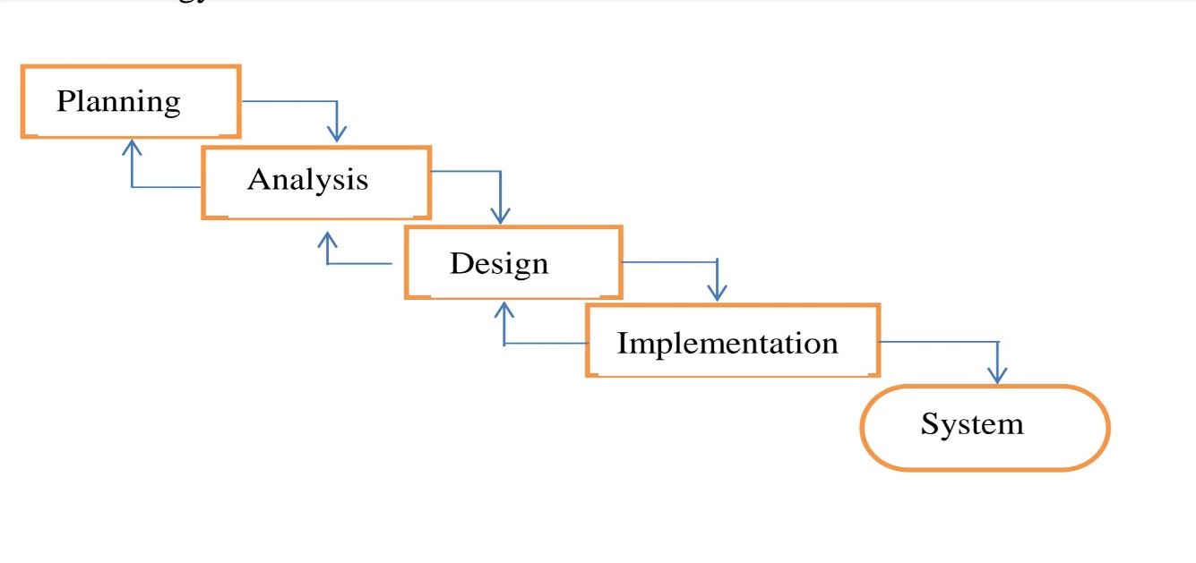
Architectural diagram
WATERFALL MODEL:

Slide 10
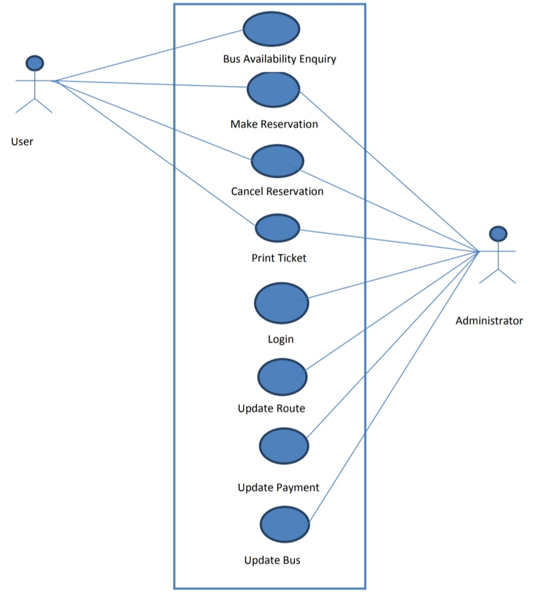
USE-CASE DIAGRAM

Slide 11

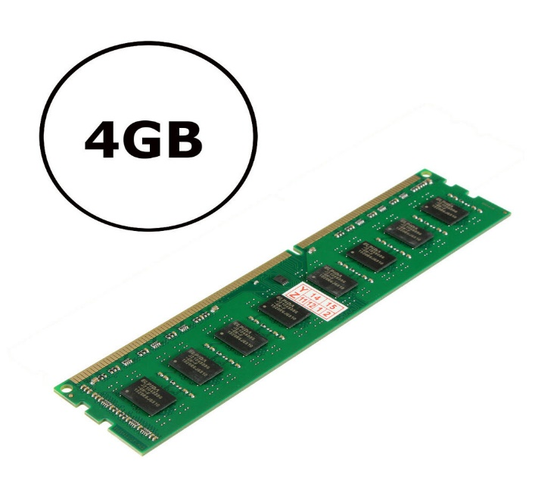
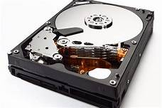
System requirements
HARDWARE REQUIREMENTS:-
Processor : i3 (or) above
RAM : minimum 512MB
Hard Disk : 50GB
Speed : 2.4 GHz+
Android mobile
SOFTWARE REQUIREMENTS:
Operating System : Windows XP (or) Higher
Coding Language : C++
Tool : Visual Studio, Turbo C++

Slide 12

CONCLUSION
The system enables customer to check availability bus ticket, buy bus tickets, and pay bus tickets online. It makes the customers easy to get bus tickets online instead queue up to buy the bus tickets.

Slide 13
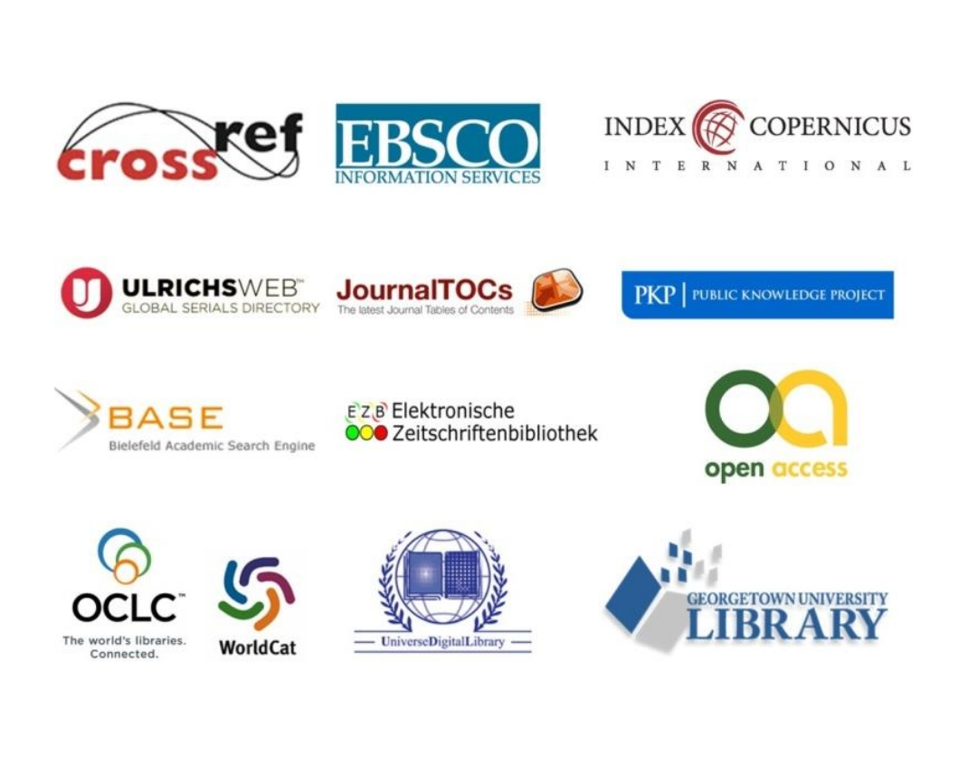
BIBLIOGRAPHY
BOOK PUBLICATION INFORMATION: http://www.iiste.org/book/
ACADEMIC CONFERENCE: http://www.iiste.org/conference/upcoming-conferences-call-for-paper/

Slide 14


